Slide 1
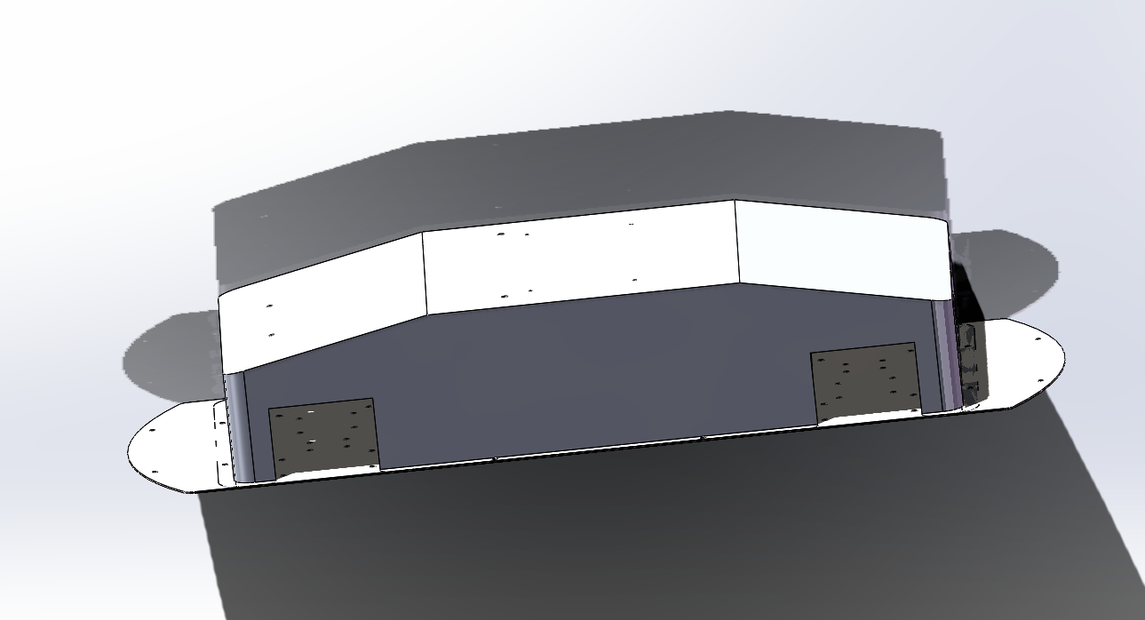
Cavity
Cavity Making
Use of stainless steel for the first version of the chamber

Slide 2
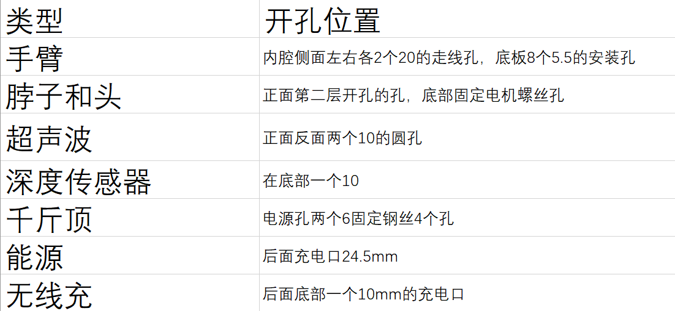
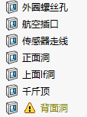
Cavity
Cavity fixed opening position

Slide 3
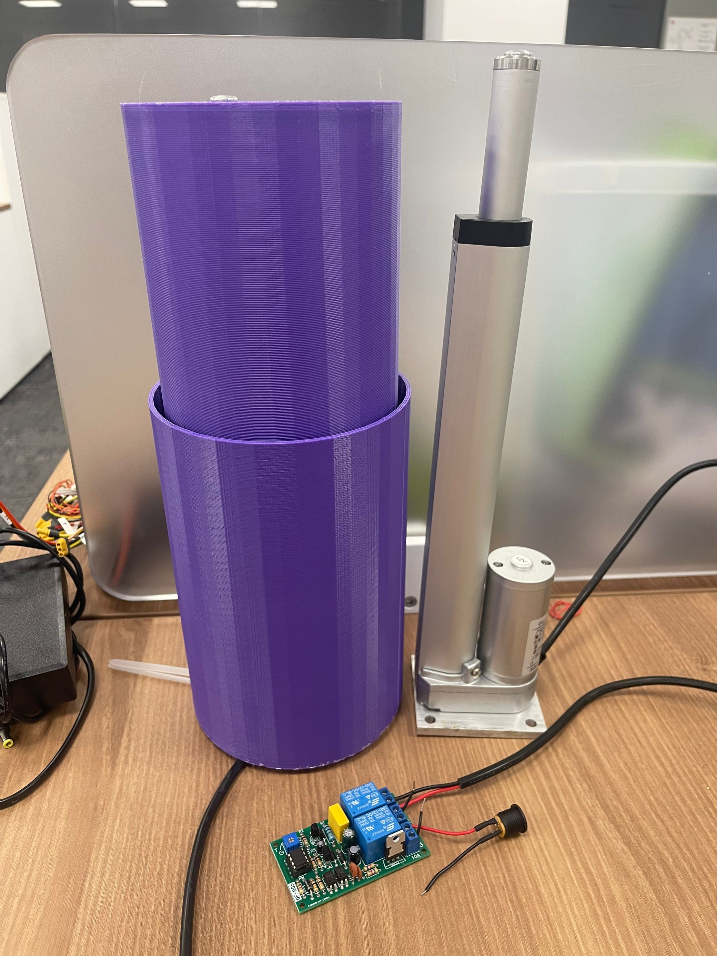
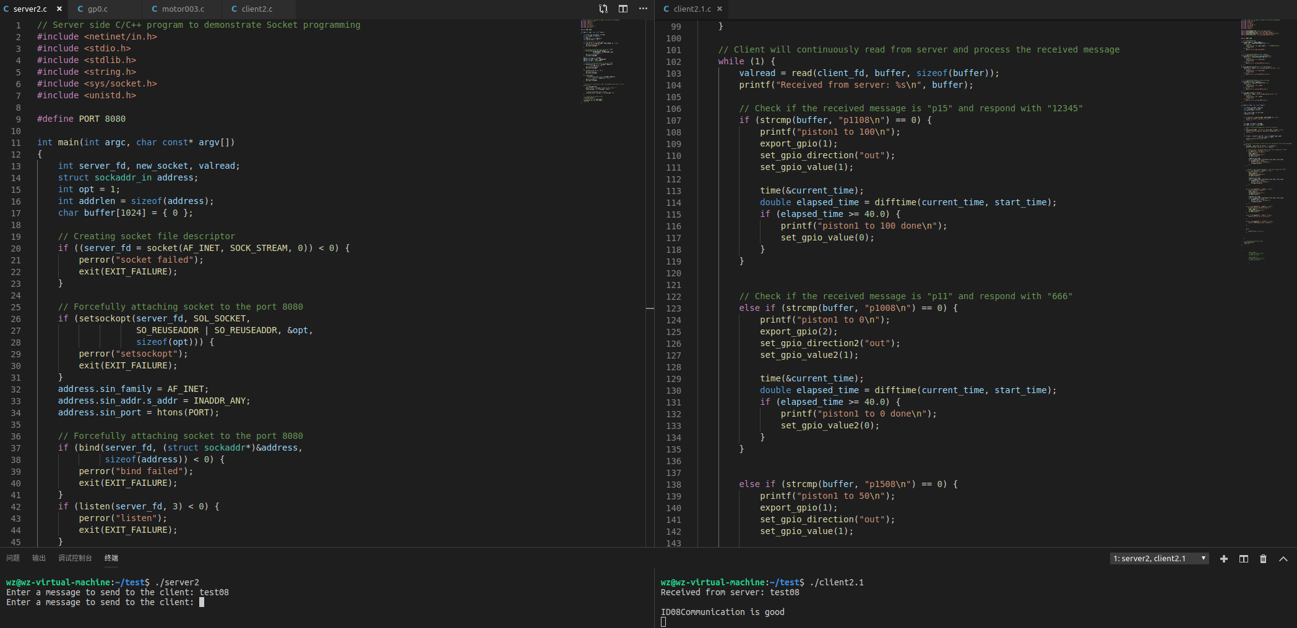
Cavity
Design of the cylinder
Physical model of the cylinder and its control code via socket communication test

